Slide 1

Perfect Ciphers
Debdeep Mukhopadhyay
and Mainack Mondal
CS 60065
Autumn 2020

Slide 2
Unconditional Security
Concerns the security of cryptosystems when the adversary has unbounded computational power, that is has infinite resources.
Cipher-text only Attack: Attack the cipher using the cipher texts only.
When is a cipher is unconditionally secured?

Slide 3
A priori and A posteriori Probabilities
The plain-text has a probability distribution
p_{P}(x): A priori probability of a plain text
The key also has a probability distribution
p_{K}(K): A priori probability of the key.
The cipher text is generated by applying the encryption function. Thus y=e_{K}(x) is the cipher text.
Note, that the plain text and the key are independent distributions.

Slide 4
Attacker wants to compute a posteriori probability of plain text
The probability distributions on P and K, induce a probability distribution on C, the cipher text.
For a key K, C_{K}(x)={e_{K}(x): x Є P}
Does the cipher text leak information about the plain text?
Given, the cipher text y, we shall compute the a posteriori probability of the plain text, ie. p_{P}(x|y) and see whether it matches with that of the a priori probability of the plain text.

Slide 5
Example
K₁
a
1
 | a | b
K₁ | 1 | 2
K₂ | 2 | 3
K₃ | 3 | 4
K₂
K₃
2
K₁
b
K₂
3
K₃
4
P={a,b}; p_{P}(a)=1/4, p_{P}(b)=3/4
K={K₁,K₂}, p_{K}(K₁)=1/2, p_{K}(K₂)= p_{K}(K₃)=1/4
C={1,2,3,4}. What the a posteriori probabilities of the plain text, given the cipher texts from C?

Slide 6
Example
K₁
p_{C}(1)=p_{P}(a)p_{K}(K₁) =(1/4).(1/2)=1/8
p_{C}(3)=p_{P}(a)p_{K}(K₃) +p_{P}(b) p_{K}(K₂) =(1/4)(1/4)+(3/4)(1/4)=1/16+3/16=1/4
Likewise I can compute the other probabilities…
a
1
K₂
K₃
2
K₁
b
K₂
3
K₃
4
P={a,b}; p_{P}(a)=1/4, p_{P}(b)=3/4
K={K₁,K₂}, p_{K}(K₁)=1/2, p_{K}(K₂)= p_{K}(K₃)=1/4

Slide 7
Example
K₁
p_{P}(a|1)=1;p_{P}(b|1)=0
p_{P}(a|2)=?
The ‘2’ can come when the plain text was ‘a’ and the key was ‘K₂’ or when the plain text was ‘b’ and the key was ‘K₁’
Given ‘2’, we need to compute the probability that it came from ‘a’.
Is it that of choosing K₂? No.
a
1
K₂
K₃
2
K₁
b
K₂
3
K₃
4
P={a,b}; p_{P}(a)=1/4, p_{P}(b)=3/4
K={K₁,K₂}, p_{K}(K₁)=1/2, p_{K}(K₂)= p_{K}(K₃)=1/4

Slide 8
Example
K₁
Given ‘2’, we need to compute the probability that it came from ‘a’.
The ‘2’ can appear with a probability:
by having ‘a’ as the PT and K₂ as the key: (1/4)(1/4)=1/16
by having ‘b’ as the PT and K₁ as the key: (3/4)(1/2)=6/16
p_{P}(a|2)=(1/16)/(7/16)=1/7
a
1
K₂
K₃
2
K₁
b
K₂
3
K₃
4
P={a,b}; p_{P}(a)=1/4, p_{P}(b)=3/4
K={K₁,K₂}, p_{K}(K₁)=1/2, p_{K}(K₂)= p_{K}(K₃)=1/4

Slide 9
Generalization of the Example

Slide 10
Perfect Secrecy
A Cryptosystem has perfect secrecy if p_{P}(x|y)=p_{P}(x) for all x Є P, y Є C.
That is the a posteriori probability that the plaintext is x, given that the cipher text y is observed, is identical to the a priori probability that the plaintext is x.

Slide 11
Shift Cipher has perfect secrecy
Suppose the 26 keys in the Shift Cipher are used with equal probability 1/26. Then for any plain text distribution, the Shift Cipher has perfect secrecy.
Note that P=K=C=Z₂₆ and for 0≤K≤25
Encryption function: y=e_{K}(x)=(x+k)mod 26

Slide 12
Perfect Secrecy

Slide 13
Theorem
Suppose (P,C,K,E,D) be a cryptosystem, where |K|=|C|=|P|. The cryptosystem offers perfect secrecy if and only if every key is used with probability 1/|K|, and for every xЄP and every y ЄC, there is a unique key, such that y=e_{K}(x).
Perfect Secrecy (equivalent): p_{C}(y|x)=p_{C}(y)
Thus if Perfect Secret, a scheme has to follow the above equation.

Slide 14
Cryptographic Properties
p_{C}(y|x)>0
This means that for every cipher text, there is a key, K, st. y=E_{K}(x)
Thus |K|≥|C|. In our case, |K|=|C|
Thus, there is no cipher text, y, for which there are two keys which take them to the same plaintext.
There is exactly one key, such that y=E_{K}(x)

Slide 15
One-time Pad
e=000 h=001 i=010 k=011 l=100 r=101 s=110 t=111
Encryption: Plaintext ⊕ Key = Ciphertext
h | e | i | l | h | i | t | l | e | r
001 | 000 | 010 | 100 | 001 | 010 | 111 | 100 | 000 | 101
Plaintext:
Key:
111 | 101 | 110 | 101 | 111 | 100 | 000 | 101 | 110 | 000
110 | 101 | 100 | 001 | 110 | 110 | 111 | 001 | 110 | 101
s | r | l | h | s | s | t | h | s | r
Ciphertext:

Slide 16
One-time Pad
Suppose a wrong key is used to decrypt:
s | r | l | h | s | s | t | h | s | r
110 | 101 | 100 | 001 | 110 | 110 | 111 | 001 | 110 | 101
Ciphertext:
“key”:
101 | 111 | 000 | 101 | 111 | 100 | 000 | 101 | 110 | 000
011 | 010 | 100 | 100 | 001 | 010 | 111 | 100 | 000 | 101
k | i | l | l | h | i | t | l | e | r
“Plaintext”:
e=000 h=001 i=010 k=011 l=100 r=101 s=110 t=111

Slide 17
One-time Pad
And this is the correct key:
s | r | l | h | s | s | t | h | s | r
110 | 101 | 100 | 001 | 110 | 110 | 111 | 001 | 110 | 101
Ciphertext:
“Key”:
111 | 101 | 110 | 101 | 111 | 100 | 000 | 101 | 110 | 000
001 | 000 | 010 | 100 | 001 | 010 | 111 | 100 | 000 | 101
h | e | i | l | h | i | t | l | e | r
“Plaintext”:
e=000 h=001 i=010 k=011 l=100 r=101 s=110 t=111

Slide 18
Unconditionally secured scheme
For a given ciphertext of same size as the plaintext, there is a equi-probable key that produces it. Thus the scheme is unconditionally secured.

Slide 19
Practical Problems
Large quantities of random keys are necessary.
Increases the problem of key distribution.
Thus we will continue to search for ciphers where one key can be used to encrypt a large string of data and still provide computational security.
Like DES (Data Encryption Standard)

Slide 20
One-time Pad Summary
Provably secure, when used correctly
Cipher-text provides no information about plaintext
All plaintexts are equally likely
Pad must be random, used only once
Pad is known only by sender and receiver
Pad is same size as message
No assurance of message integrity
Why not distribute message the same way as the pad?

Slide 21
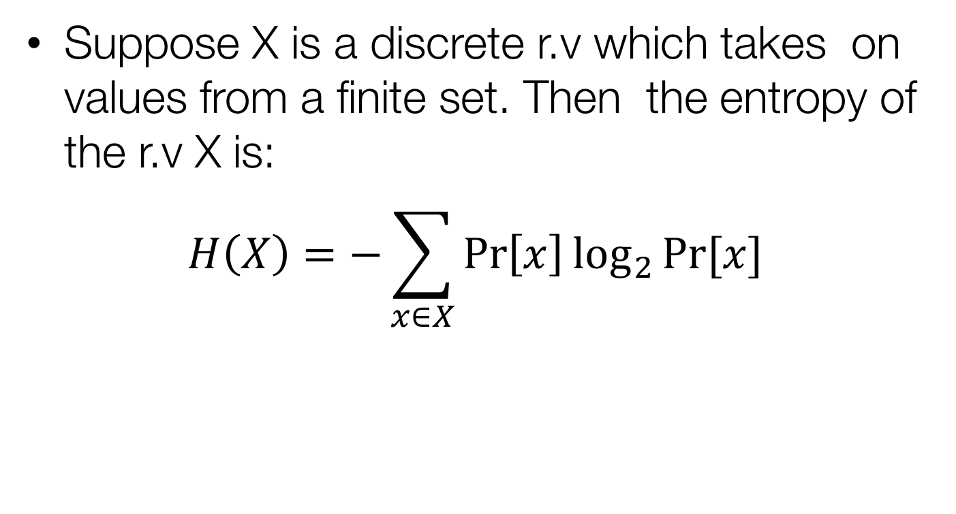
Entropy
Suppose X is a discrete r.v which takes on values from a finite set. Then the entropy of the r.v X is:
$$H\left(X\right)=−\sum_{x∈X}{\operatorname{Pr}\left[x\right]\log_{2}{Pr⁡[x]}}$$

Slide 22
Entropy Revisited
P={a,b}; p_{P}(a)=1/4, p_{P}(b)=3/4
K={K₁,K₂,K₃}, p_{K}(K₁)=1/2, p_{K}(K₂)= p_{K}(K₃)=1/4
What is H(P)?
H(P)=(1/4)log₂(4)+(3/4)log₂(4/3)≈0.81
H(K)≈1.5
H(C)≈1.85

Slide 23
Huffman Encoding
Consider S: a discrete source of symbols
The messages from S: {s1,s2,…,sk}
Can we encode these messages such that their average length is as short as possible, and hopefully equal to H(S)?
Huffman Code provides an optimal solution to this problem.

Slide 24
Informal Description
The message set X has a probability distribution. Arrange them in ascending order:
p(x1)≤p(x2) ≤p(x3)… ≤p(xj)
Initially the codes of each element are empty.
Choose the two elements with minimum probabilities
Merge them into a new letter, say x12 with probability as the sum of x1 and x2. Encode the smaller letter 0 and the larger 1.
When only one element remains, the code of each letter can be constructed by reading the sequence backwards.

Slide 25
Example
X={a,b,c,d,e}
p(a)=.05, p(b)=.10, p(c)=.12, p(d)=.13, p(e)=.6
H(X)=1.7402

Slide 26
Illustration of the encoding
a | b | c | d | e
.05 | .10 | .12 | .13 | .6
0 | 1
 |  | .12 | .13 | .6
 |  | 0 | 1
x | f(x)
a | 000
b | 001
c | 010
d | 011
e | 1
.15
.15
.25
.6
0
1
0.4
0
1
1

Slide 27
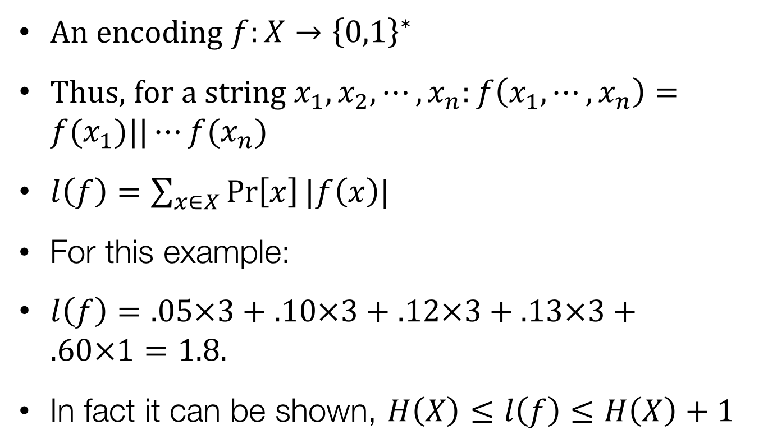
Average Length Encoding
An encoding $f:X→{\left\{0,1\right\}}^{∗}$
Thus, for a string $x_{1},x_{2},⋯, x_{n}:f\left(x_{1},⋯, x_{n}\right)=f(x_{1})||⋯f(x_{n})$
$l\left(f\right)=\sum_{x∈X}{\operatorname{Pr}\left[x\right]|f\left(x\right)|}$
For this example:
$l\left(f\right)=.05×3+.10×3+.12×3+.13×3+.60×1=1.8.$
In fact it can be shown, $H\left(X\right)≤l\left(f\right)≤H\left(X\right)+1$

Slide 28
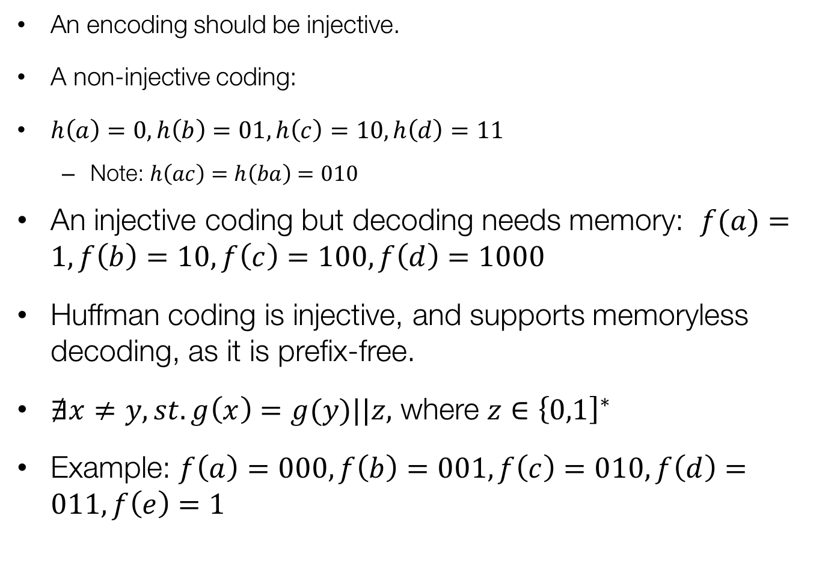
Decoding
An encoding should be injective.
A non-injective coding:
$h\left(a\right)=0,h\left(b\right)=01,h\left(c\right)=10,h\left(d\right)=11$
Note: $h\left(ac\right)=h\left(ba\right)=010$
An injective coding but decoding needs memory: $f(a)=1,f\left(b\right)=10,f\left(c\right)=100,f\left(d\right)=1000$
Huffman coding is injective, and supports memoryless decoding, as it is prefix-free.
$∄x≠y, st. g\left(x\right)=g(y)||z,$ where $z∈{\left\{0,1\right]}^{∗}$
Example: $f\left(a\right)=000,f\left(b\right)=001,f\left(c\right)=010,f\left(d\right)=011,f\left(e\right)=1$

Slide 29
Some more results on Entropy
X and Y are random variables.
H(X,Y)≤H(X)+H(Y)
When X and Y are independent:
H(X,Y)=H(X)+H(Y)
Conditional Entropy:
H(X|Y)=-Σp(x|y)log₂p(x|y)
H(X,Y)=H(Y)+H(X|Y)
H(X|Y)≤H(X)
When X and Y are independent: H(X|Y)=H(X)

Slide 31
Theorem
Let (P,C,K,D,E) be an encryption algorithm. Then
H(K|C)=H(K)+H(P)-H(C)
Proof: H(P,K)=H(C,K) [why?]
or, H(P)+H(K) = H(K|C)+H(C)
or, H(K|C)=H(K)+H(P)-H(C)
Equivocation (ambiguity)
of key given the ciphertext

Slide 32
Perfect vs Ideal Ciphers
H(P)=H(C), then we have H(K|C)=H(K)
That is the uncertainty of the key given the cryptogram is the same as that of the key without the cryptogram.
Such kinds of ciphers are called “ideal ciphers”
For perfect ciphers, we had H(P)=H(P|C) or, equivalently H(C)=H(C|P)

Slide 33
Perfect vs Ideal Ciphers
For perfect ciphers, the key size is infinite if the message size is infinite.
however if a shorter key size is used then the cipher can be attacked by someone with infinite computational power.
Thus, H(K|C) gives us this idea of security (or, insecurity).

Slide 34
Unicity and Brute Force Attack
Q: How to protect data against a brute force attacker with infinite computation power?
Shannon defined “unicity distance” (we shall call it unicity), as the least amount of plaintext which can be deciphered uniquely from the corresponding ciphertext: given unbounded resources by the attacker.
Often measured in units of bytes, letters, symbols.

Slide 35
An Important Point
A common misconception: “any cipher can be attacked by exhaustively trying all possible keys”:
Thus DES which has a 56 bit key can also be broken by brute force.
But if the cipher is used within its unicity then even DES is theoretically secured, like the One Time Pad (OTP).

Slide 36
Spurious Keys
Thus, H(K|C) is the amount of uncertainty that remains of the key after the cipher text is revealed.
We know, it is called the key equivocation
Attacker to guess the key from the ciphertext shall guess the key and decrypt the cipher.
He checks whether the plaintext obtained is “meaningful” English. If not, he rules out the key.
But due to the redundancy of language more than one key will pass this test.
Those keys, apart from the correct key, are called spurious.

Slide 37
Entropy of Plain Text
H_{L}: measure of the amount of information per letter of “meaningful” strings of plaintext.
A random string of plaintext formed using English letter has an entropy of log₂|26|≈4.76
But English letters have a probability distribution.

Slide 38
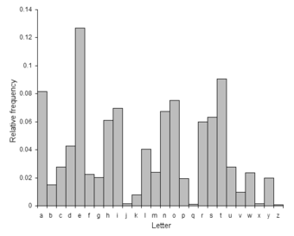
Frequency of English letters
A first order
entropy
of the English
text
is H(P)≈4.76

Slide 39
In general…
Successive letters have correlation, which reduces the entropy.
Define P_{L} to be the random variable that has a probability distribution of n-grams of plaintext
Define H_{L} as the entropy of a natural language L:

Slide 40
Redundancy
Entropy of the language
Fraction of
“excess letters”
Entropy of the
random
language
For English Language, 1≤H_{L}≤1.5. Considering H_{L}=1.25, and |P|=26, R_{L}≈0.75.
English Language is 75% redundant.

Slide 41
A lower Bound of equivocation of key
P^{n}: r.v representing n-gram plaintext
C^{n}: r.v representing n-gram ciphertext
H(K|C^{n})=H(K)+H(P^{n})-H(C^{n})
H(P^{n})≈nH_{L} (assuming large n)
=n(1-R_{L})log₂|P|
H(C^{n})≤nlog₂|C|
If |P|=|C|,
H(K|C^{n})≥H(K)-nR_{L}log₂|P|

Slide 42
Possible Keys
Define, K(y)={possible keys given that y is the ciphertext}
that is K(y) is the set of those keys for which y is the ciphertext for meaningful plaintexts
When y is the ciphertext, number of keys is |K(y)|
Out of them, only one is correct. Rest are spurious.
So, number of spurious keys=|K(y)|-1

Slide 43
Expected number of spurious keys
Expected number of spurious keys=average number of spurious keys over all possible ciphertexts is denoted by s_{n}.

Slide 44
Computing the upper bound of equivocation of key
=

Slide 45
Lower Bound of spurious keys
Combining the previous results:
If the keys are chosen equi-probably:
H(K)=log₂|K|. Hence, we have:

Slide 46
Unicity Distance
Thus increasing n, reduces the number of spurious keys.
Unicity Distance is the number of ciphertexts, n₀ for which the number of spurious keys is reduced to zero.
This calculation may not be accurate for large values of n

Slide 47
Unicity Distance for Substitution Ciphers
|P|=26
|K|=26!≈4 x 10²⁶, R_{L}=0.75
n₀=25 (approx)
Given a ciphertext string of length 25, it is possible to predict the correct key uniquely
Thus key size alone does not guarantee security, if brute force is possible to an attacker with infinite computational power.

Slide 48
Take Home Assignment
Let n be a positive integer. A Latin square of order n is an nxn array L with integers 1,2,…,n such that every integer occurs exactly once in each row and column. An example for n=3 is:
1 | 2 | 3
3 | 1 | 2
2 | 3 | 1

Slide 49
Take Home Assignment
Given any Latin square of order n, we can define a related cryptosystem, e_{i}(j)=L(i,j), where 1≤i,j≤n.
Prove from the computation of probabilities that the Latin square cryptosystem achieves perfect secrecy.

